Slide 1


BLOOD+
Health Technology
CONNECTING REQUESTORS WITH BLOOD DONORS
app.novanex.tech

Slide 2


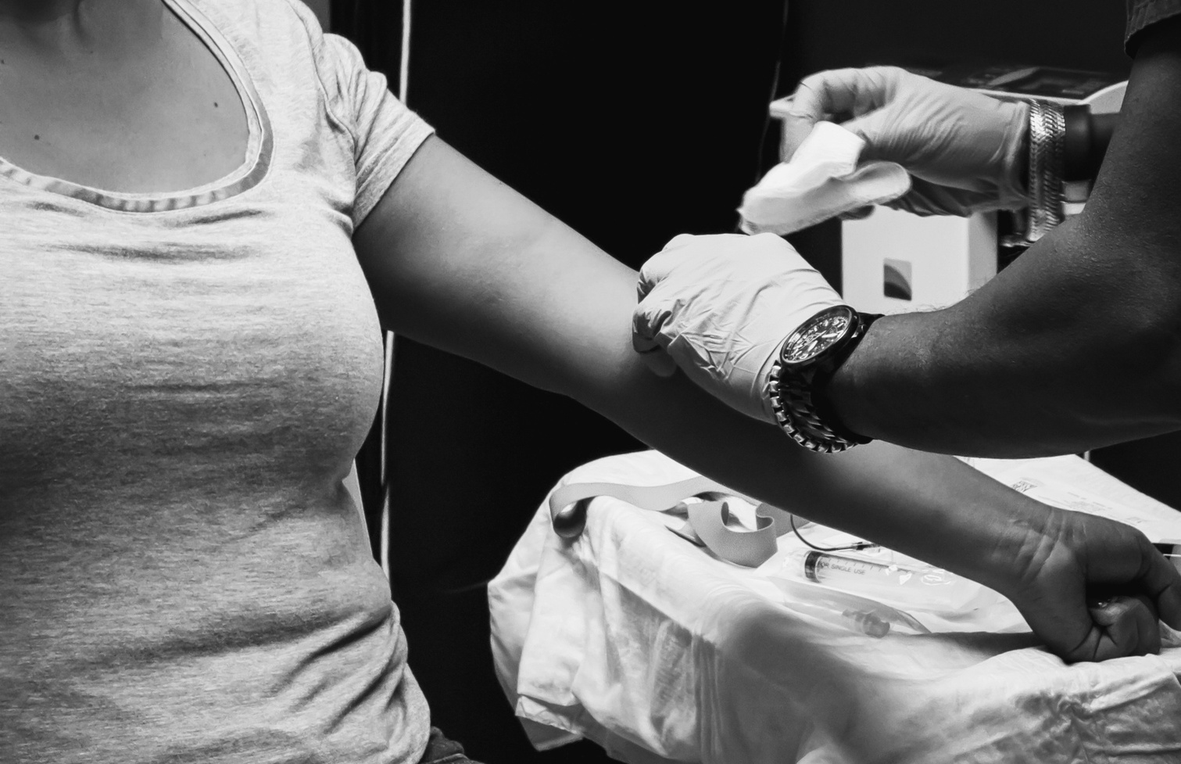

PROBLEM
In many African hospitals, the availability of blood for patients in need is a critical challenge. Hospitals often lack sufficient blood stocks, leading to delays in emergency situations or the burden of purchasing replacement blood falling on the patient's family. There is a need for a reliable and efficient system to connect blood donors with those in need and ensure a timely and accessible supply of blood in local communities.

Slide 3

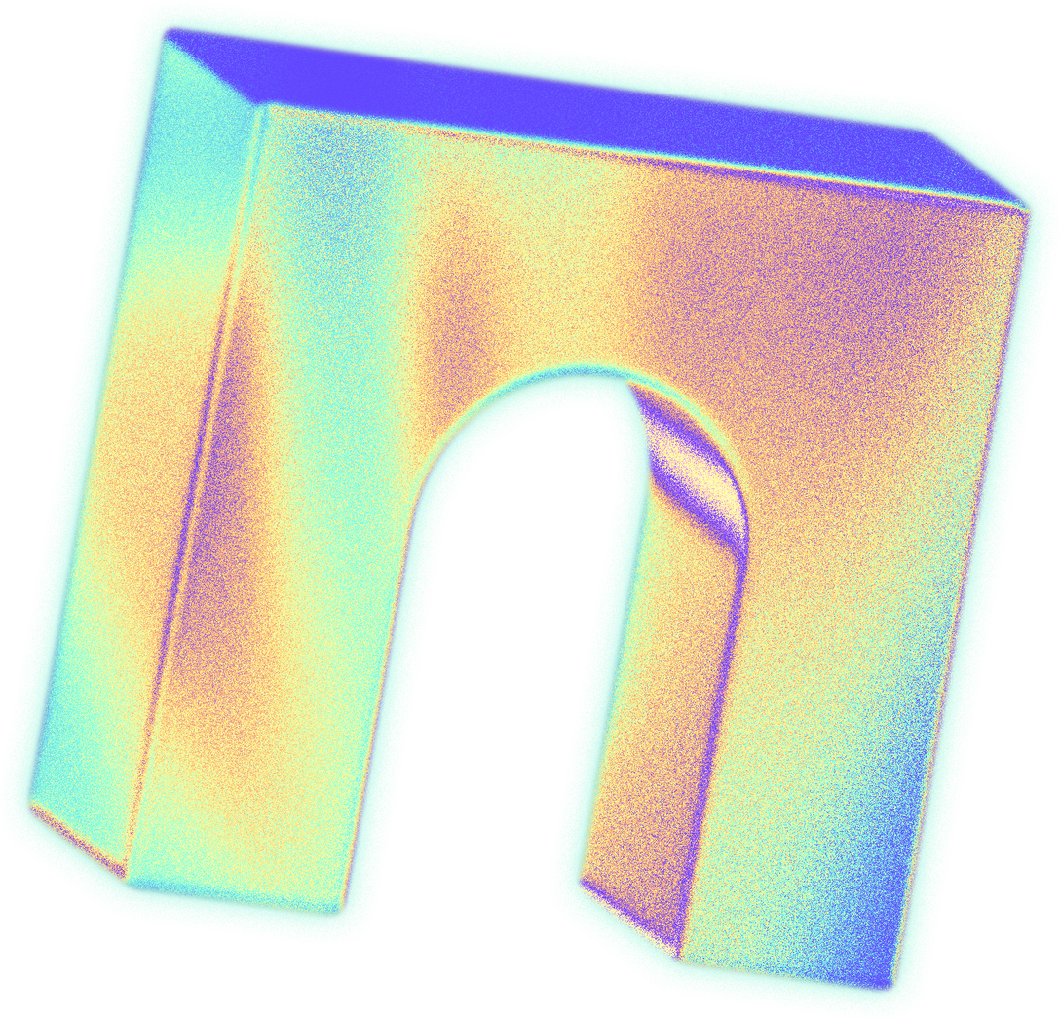

APP FEATURES
BLOOD DONATION HISTORY
USER REGISTRATION AND PROFILE MANAGEMENT
EMAIL NOTIFICATIONS
BLOOD DONATION REQUEST
REAL TIME LOCATION-BASED MATCHING
SECURED COMMUNICATION
VERIFICATION AND RATINGS

Slide 4

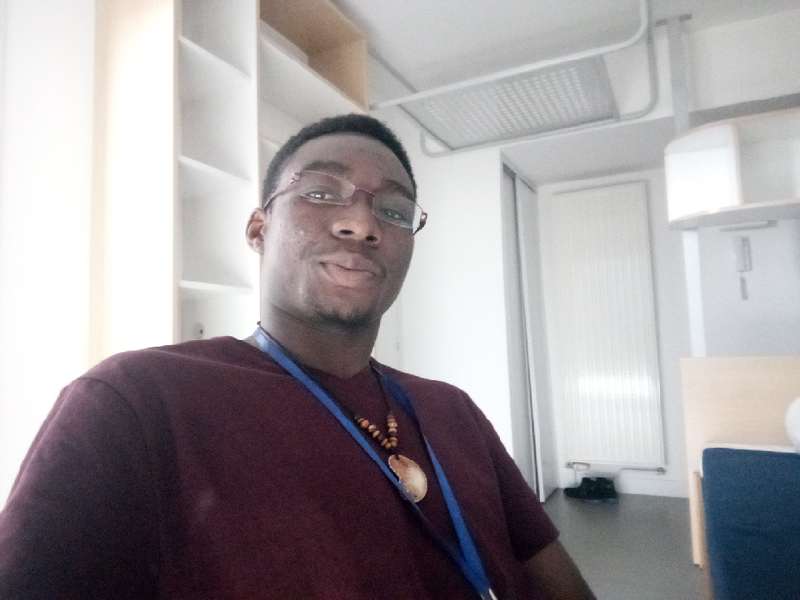

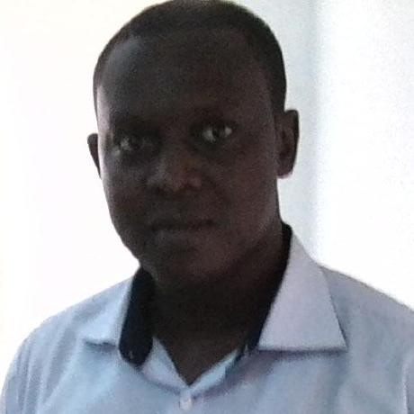
TEAM
Yaninthe Tiomene
Backend
Esmond Adjei
Backend/Frontend
Gregory Slippi-Mensah
Frontend

Slide 5
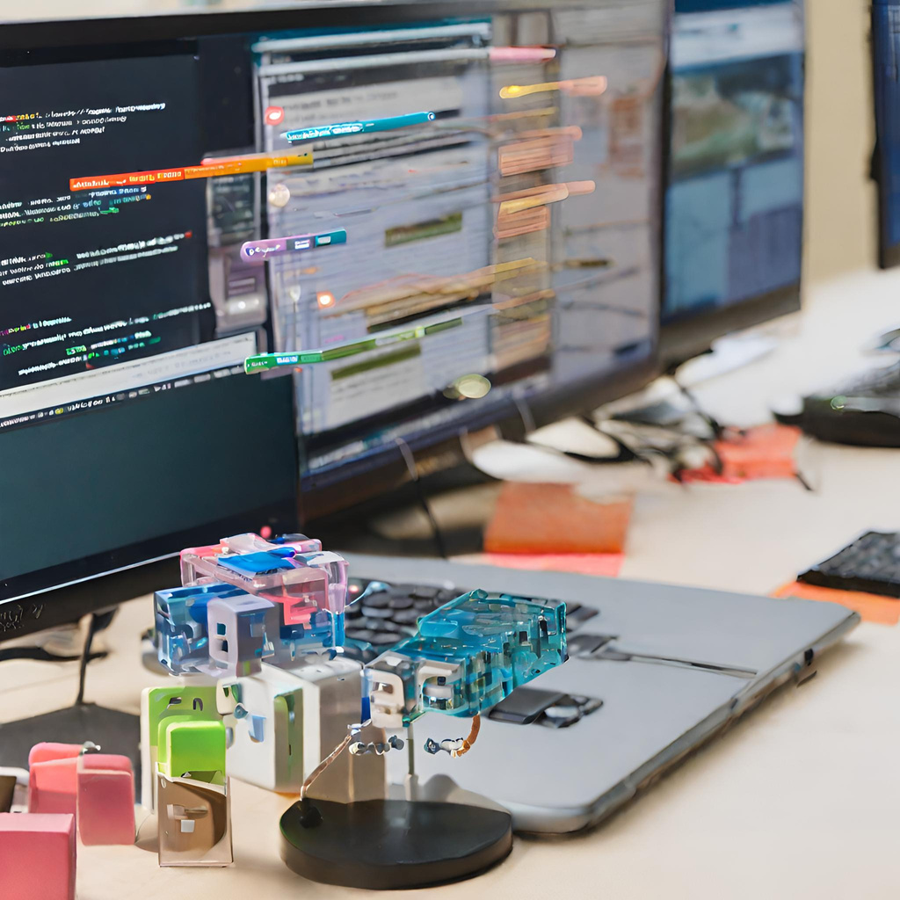
TECHNOLOGY
BACKEND
FRONTEND
Node.js
Express
PostgresSQL + Postgis
Redis
Google Maps API
Gmail API
CSS
HTML
TypeScript
Next.js
PROJECT MANAGEMENT/CODE VERSIONING
Trello
Git/Github

Slide 6

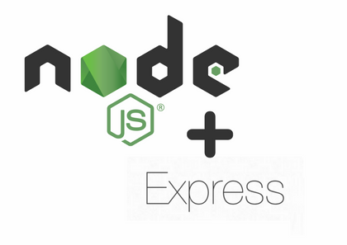


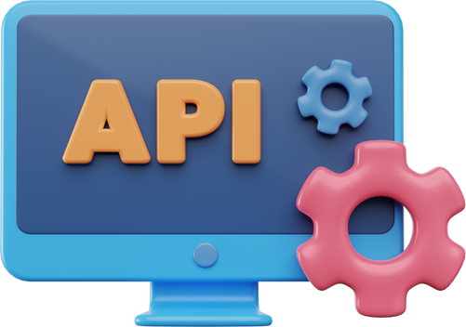


ARCHITECTURE
Server side (Back-end)
Client side (Front-end)
Databases
External APIs

Slide 7
PROJECT MOMENTUM
PLANING AND RESEARCH
MVP DEVELOPMENT
TESTING AND QA
DEPLOYMENT AND LAUNCH
NEXT ITERATION
We spent the first week researching and planning our project, deciding on the scope and features we wanted to include.
Once we had a solid plan in place, we began designing and developing the MVP, focusing on building the core functionality of the web application.
While building the app, we tested and corrected the code.
After several rounds of testing and QA of a feature, we deployed it. The project is yet to be launch to the public
Add new features (messaging, verification and ratings), test , deploy and launch the application to the public

Slide 8
DEMO

Slide 9
CHALENGES
Integration Complexities:
Description: Integrating frontend and backend components posed challenges due to differences in technologies and data exchange formats.
Solution: Implemented a robust API layer and used standardized data formats (JSON) for seamless communication. Regular collaboration and code reviews facilitated smoother integration.
Challenge 3:
Challenge 2:
Description:
Solution:
Description:
Solution:

Slide 10

Technical interests: Insights gained
API Integration Proficiency:
Frontend-Backend Collaboration:
Successfully integrating with Google maps API for real time location-based matching and Gmail API for email notification enhanced our understanding of handling third-party APIs,
Collaborating on a project with distinct frontend and backend components improved our skills in coordinating development efforts, API design, database with a Postgis extension and data exchange.

Slide 11
Technical interests: Future Technical Interests
Advanced Frontend Frameworks:
Cybersecurity Considerations:
Machine Learning Integration:
Exploring and mastering advanced frontend frameworks like React, Vue.js, or D3.js to enhance the user interface and interactivity.
Developing a deeper understanding of cybersecurity aspects, focusing on securing user data, API interactions, and ensuring the application's resilience against potential threats.
Investigating possibilities of integrating machine learning algorithms for personalized insights and chatbot, for users support

Slide 12

BLOOD+ APP
THANKS EVERYONE
JOIN US AND GIVE YOUR BLOOD TO SAVE ONE LIFE

